Slide 1
Rajiv Gandhi Institute of Technology Kottayam
Presentation to ABC

Slide 2
Contents
Review of College
Department of Mechanical Engg
Industrial Engg & Management
Additional Information

Slide 3
College Information
Owned by Government of Kerala, celebrating ‘Silver Jubilee’ in 2015-16.
Vast campus with 67 acres of land.
Affiliated to APJ KTU / MG University.
6 UG, 7 PG and 2 PhD programmes.
NBA Accredited UG programmes, TEQIP and QEEE institute.
Ranked amoung the top five state engineering colleges, Rated ‘Outstanding’
(2nd best in Kerala) by RECCAANIT, Graded AAA+ by Careers 360.

Slide 4
Courses
Dept | UG (B.Tech) | PG (M.Tech) | Research (PhD)
Electrical | BTech | Industrial Drives & Control | Research Center
Mechanical | BTech | Industrial Engg & Management
Civil | BTech | Transportation Engg | Research Center
Electronics | BTech | Advanced Communication & Information System; Advanced Electronics and Communication Engg
Computer Science | BTech | Computer Science & Engg
Architecture | BArch

Slide 5
Highlights
Infrastructure: Independent blocks for department, Latest lab facilities
B.Tech programmes have been NBA accredited for 3 years (w.e.f Jan 2016)
Quality Faculty: 22 PhD holders, Ave. 12 years experience
Centers & Projects: KTU Cluster Lead Institution, CERD, TEQIP (Phase 2), DST
Professional bodies: IEEE, SAE, IIIE, EEA, IAS
International Faculty interactions: Abudhabi, Singapore, Canada, China, USA, Italy, Japan, Switzerland, Malaysia
Outcomes:
- Good number of University ranks each year
- 60-70% placement from eligible candidates, 2 in Civil Services
- More than 100 Publications in Conferences and Journals, 2 Books, 2 Patents
- 9 MoUs, 4 Startups (within campus), 4 Startups in Startup Village

Slide 6
U.G Admission Ranks (State Merit)
 | Year of Admission
Programme | 2012 | 2013 | 2014 | 2015
 | First-Last | First-Last | First-Last | First-Last
Civil Engineering | 2915- 6690 | 3082-7913 | 3476-6046 | 2083-5003
Computer Science | 1343-4780 | 1491-6103 | 2066-7977 | 1456-5224
Electrical Engineering | 2267-4651 | 1105-5700 | 1613-5100 | 1008-5948
Electronics & Communication | 734-5982 | 882-3887 | 1162-3723 | 1192-5774
Mechanical Engineering | 478-2593 | 1104-3395 | 1139-3359 | 744-3515

Slide 7
University Rank Details
Branch | 2013-14 | 2012-13 | 2011-12
EC | B.Tech II Rank M.Tech I , II & III Rank
CS
ME | M.Tech Ist Rank & III Rank | M.Tech I & II Rank | B.Tech First Rank, M.Tech I , II & III Rank
CE | M.Tech I , II & III Rank |  | B.Tech First and Second Rank
EEE | M.Tech I , II & III Rank | M.Tech I , II & III Rank | M.Tech I , II & III Rank

Slide 8
Campus Placement
Microsoft
Oracle
I B M
Infosys
Wipro
T C S
UST Global
Larsen and Toubro
H C L
Accenture
I B S
SunTec
M R F
Shapoorji Pallonji
South Indian Bank
Idea
E L G I
Mphasis
Lister
Verizon
NeST
AQ
QBurst
TATA ELXSI
180 students placed in 2016

Slide 9










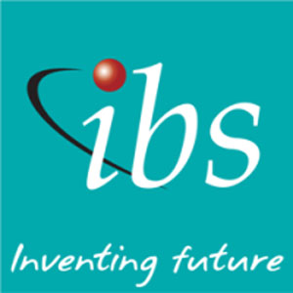

Recruiters

Slide 10













Recruiters

Slide 11
RIT Alumni
Public Sector
IPS (Govt of India)
Irrigation Dept (Govt of Kerala)
ISRO and VSSC (Trivandrum)
Kerala Productivity Council (Kochi)
Kerala PWD, KSEB, BPCL, BHEL, HAL
Private Sector
Mircosoft, Oracle, TCS, Infosys
L& T, Volvo, MRF, Reliance, Daimler, V-Guard, Entuple, GE, Siemens, Lamprell Energy Ltd
Nest, Tata Elxsi, Bosch
Educational Institutions:
RIT (Kottayam), METS (Mala),
AJCE (Kanjarapally), SCMS (Kochi),
SGITS (Kottayam), MEC (Ettumanoor), KITS (Kottayam), CoE (Kidangoor), CoE(Alleppy), SBCS (Kayamkulam)
Higher Studies (MTech, PhD)
IIT, IISC, NIT, CUSAT, Pondicherry University, Kerala University, Hyderabad University, University of Southern Queensland Australia

Slide 12
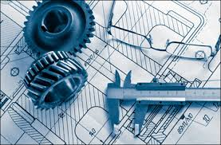
Mechanical Engineering

Slide 13
Achievements
(Academics, Placement, Higher Studies, Startups)
NBA accredited for 3 years w.e.f 1/1/2016.
Academics: Was one among two teams from Kerala selected for the main event of Efficycle, SAE India.
- Secured 1st prize in Auto Quiz, SAE India Students Convention.
- Secured 1st prize in automobile prototyping, Indian Institute of Technology Kanpur.
- Secured 3rd prize in National Mechanical CAD design context, SAE Tier-3
Competition.
- Skills: Design using CATIA/ANSYS/SOLIDWORKS/MATLAB, Rapid Prototyping,
CNC machining
Good projects: 1 patent, 3 published papers

Slide 14
Achievements
(Academics, Placement, Higher Studies, Startups)
Publications: more than 60 conference and journal publications over past 5 years.
Core Placements: TATA Materials Bangalore, TCS (EIS), MRF, Al Adrak Oman
Higher studies: MTech (Design Engineering) IIT Delhi, MS (AeroSpace) University of Buffalo US, MS (Mechanical Engineering) University of Southern Queensland Australia, MTech (Materials) NIT Trichy, MS (Mech Engg) Huston University, MS(AeroSpace) Beijing University
Startup: Rinine Engineering Pvt. Ltd. started, first of its kind in Kerala, focuses on design and development, runs in Department of Mechanical Engg

Slide 15
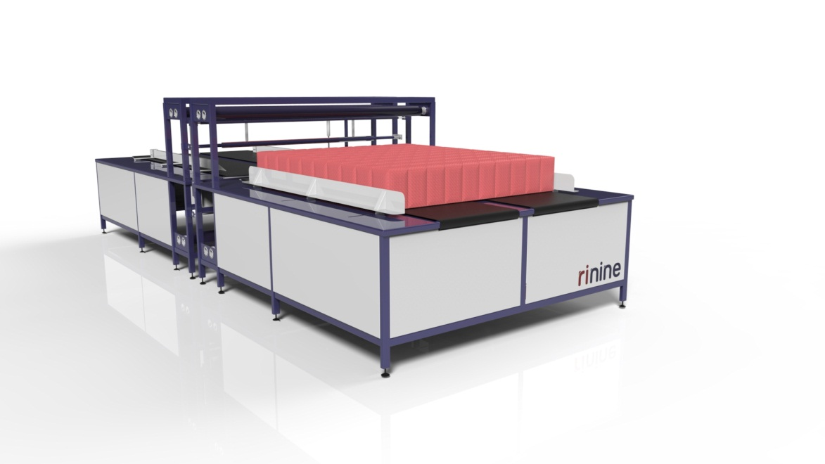
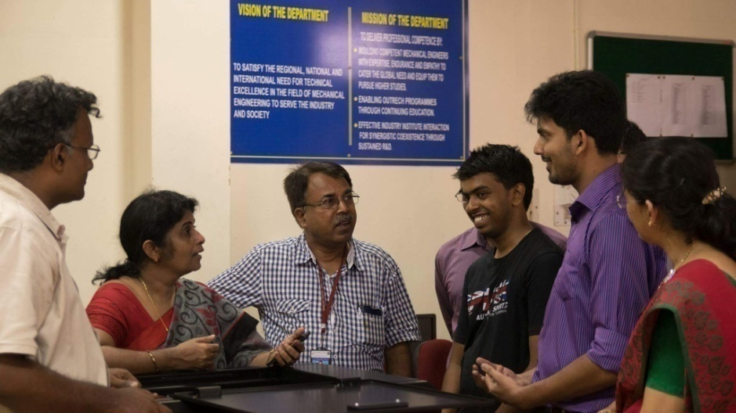
Technology Business Incubation Center
Four startups in core engineering fields are presently working from within the campus. Prominent among them, started by Mechanical Engineering students, is Rinine Engineering Pvt. Ltd. currently serving the design, analysis and prototyping requirements of both local and oversea clients.

Slide 16
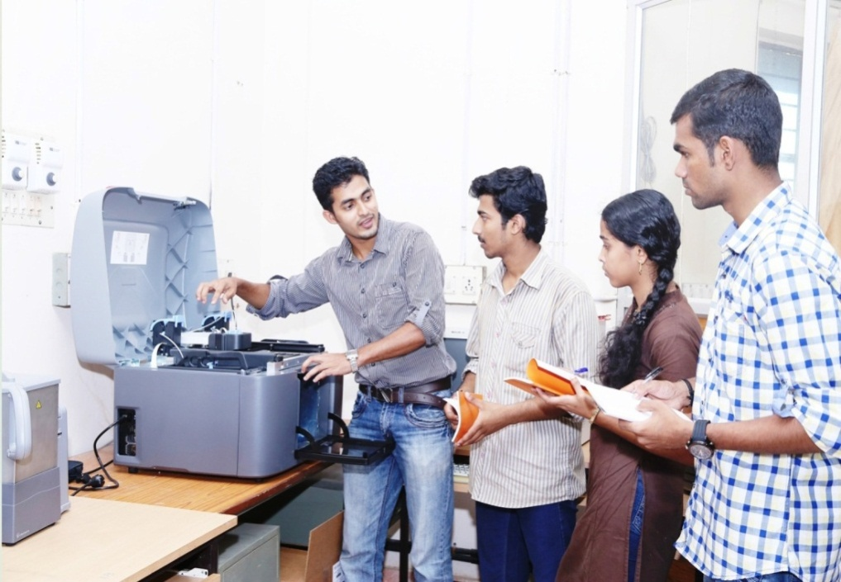
Lab Facilities
Heat Engine Lab
Heat Transfer Lab
CAD/CAM Lab
Fluid Mechanics Lab
Hydraulics Lab
Measurement Lab
Mechanical Engineering Lab
Refrigeration & Air Conditioning Lab
Industrial Engineering Lab
Ergonomics Lab
Mechanical Workshop
CAD-CAM Center

Slide 17
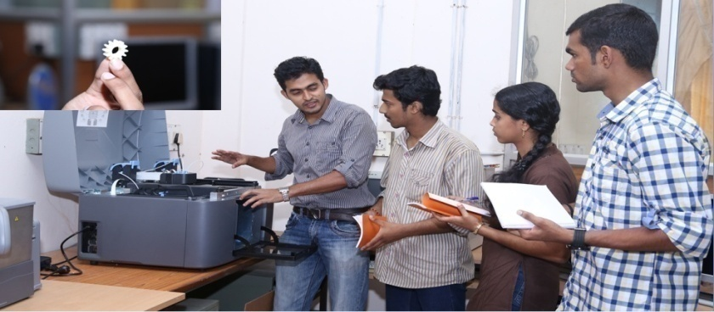
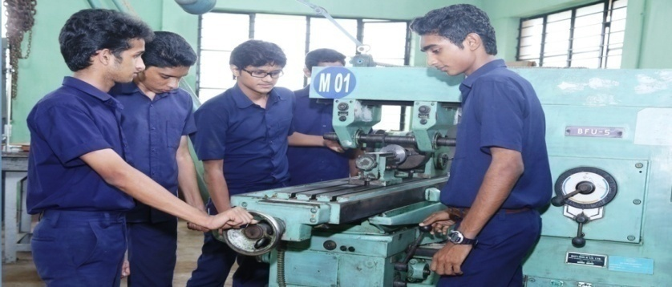
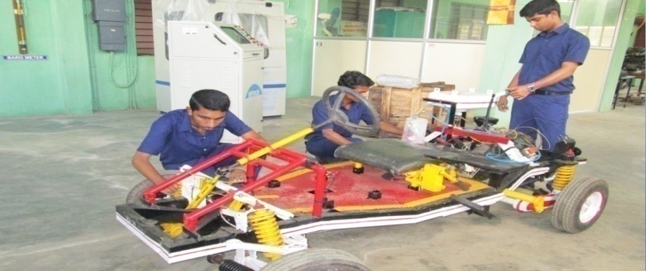
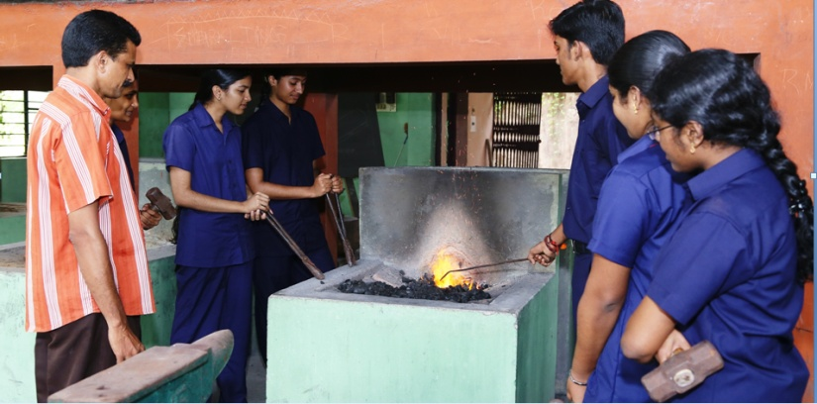
New CAD/CAM Lab
Machine Shop
Heat Engines Lab
Mechanical Workshop

Slide 18
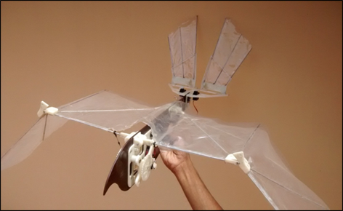
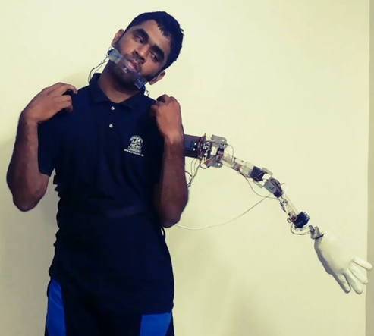
Academic Projects
The Projects undertaken by students included many design, analysis and fabrication works in aeronautical, automobile and marine using high end softwares like CATIA, SolidWorks, ANSYS, Matlab etc.
They also undertake CFD analysis.
Ornithopter
Anthropomorphic robotic hand

Slide 19
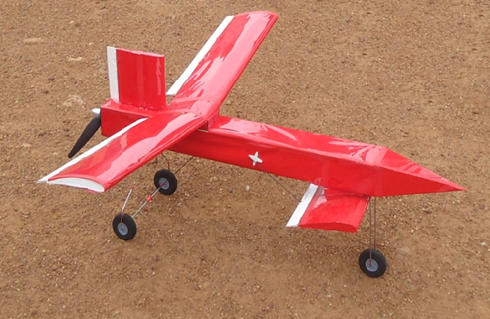
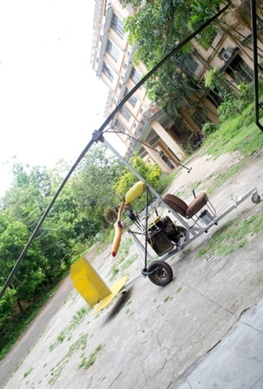
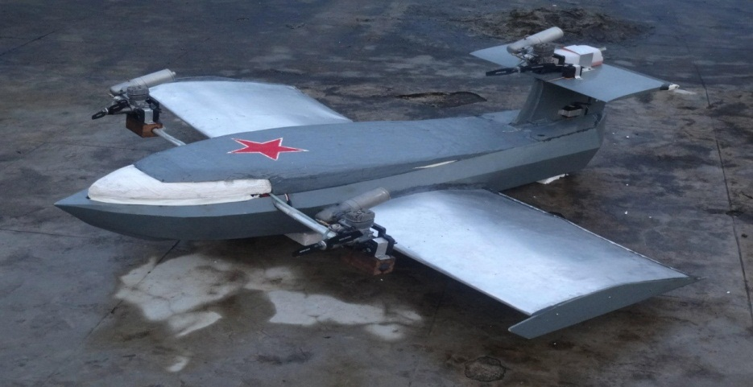
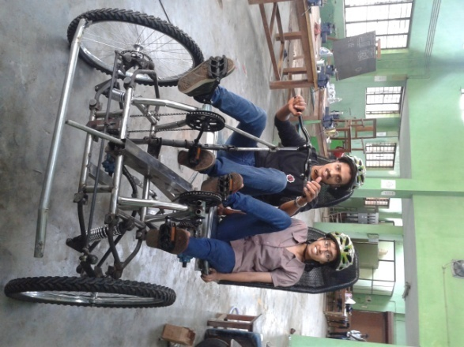
Academic Projects
Unmanned Areal Vehicle
Gyrocopter
Efficycle
Wing in Ground Effect Craft

Slide 20
Industrial Engineering & Management

Slide 21
Course and Outcome
Started in 2005, Interdisciplinary, GATE qualified students
Specialized training in Industrial Engg Lab, Software Lab, Ergonomics Lab
Software exposure: SPSS, MATLAB, MS Project, Witness, CATIA, MATLAB,
MVTA
Industry Exposure through ‘Industrial Training’ (2-3 months) and
‘Industry Projects’ (6 months)
Average Faculty experience is > 20 years
Industry exposure/Projects/Consultancies:
  RUBCO, ISRO, FPI-OEN, EASTERN CONDIMENTS, TELK,
  KMML, STAR PIPES, KEL, MALABAR CEMENTS,
  KAL, HLL, KERALA STATE CONSTRUCTION CORP, PKC,
  AUTOCAST, IRE, NATPAC, NTPC

Slide 22
Course and Outcome
> 60 journal and conference publications in past three years
held 3 conferences
held > 15 Industry Experts Sessions
University Rank Details
2013-14 | 2012-13 | 2011-12
M.Tech 1st, 3rd | M.Tech 1st, 2nd | M.Tech 1st , 2nd , 3rd

Slide 23
MTech Alumni
Public Sector
IPS (Govt of India)
Irrigation Dept (Govt of Kerala)
ISRO and VSSC (Trivandrum)
Kerala Productivity Council (Kochi)
Private Sector
MRF (Kottayam)
V-Guard Industries Ltd (Kochi)
Entuple Bangalore
Lamprell Energy Ltd (UAE)
TCS (Trivandrum)
Educational Institutions:
RIT (Kottayam), METS (Mala),
AJCE (Kanjarapally), SCMS (Kochi),
SGITS (Kottayam), MEC (Ettumanoor), KITS (Kottayam), CoE (Kidangoor), CoE(Alleppy), SBCS (Kayamkulam)
Higher Studies (PhD)
NIT, Calicut
CUSAT, Kochi
Pondicherry University
Kerala University

Slide 24
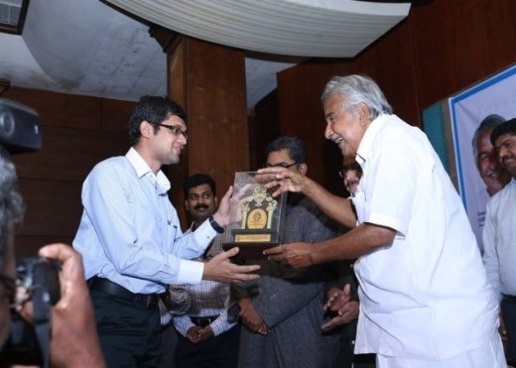
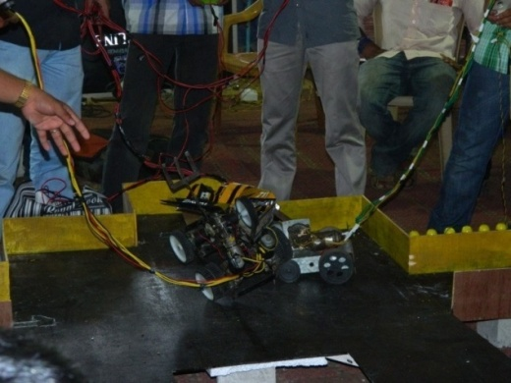
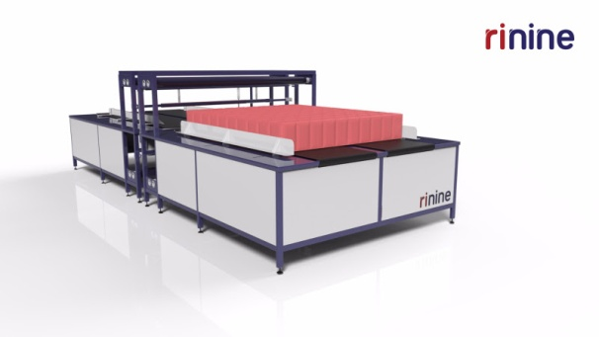
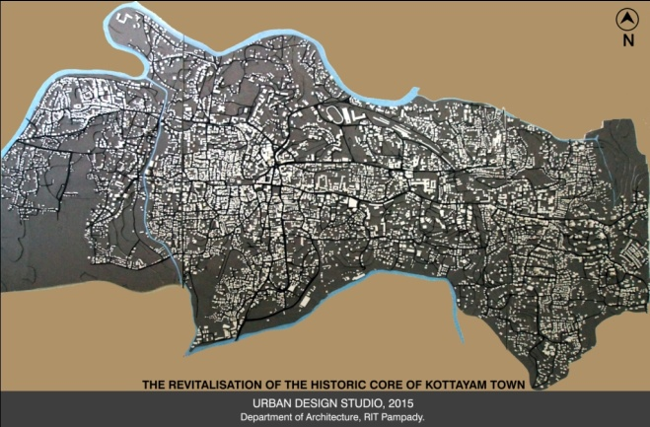

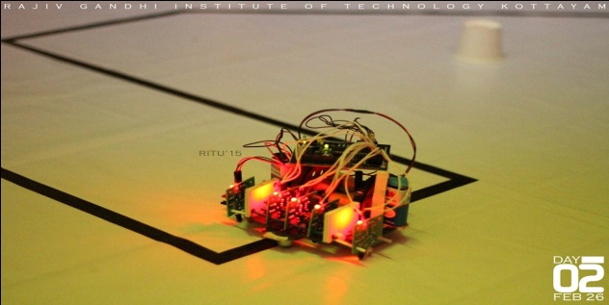
Campaign
Inspire
Aspire
Visibility
IIIC
SAE
IEEE
EDC
CERD
Alumni

Slide 25
MoUs
RUBCO Kottayam
Centre for Nano science and Nano Technology, M.G University
Irrigation Department of Kerala, Govt of Kerala
Tropical Institute of Science, Kottayam
Cranes Software, Bangalore
Entuple Technologies, Bangalore
Poornam Vision Software Ltd, Cochin
OTTOTRACTIONS, Empanelled Accredited Energy Auditor,
Bureau of Energy Efficiency, Government Of India
C-DAC( Centre for Development of Advanced Computing)
Trivandrum

Slide 26
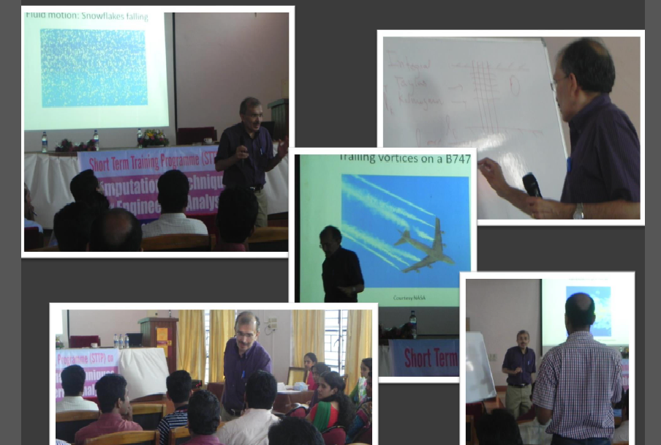
Expert Lecture Sessions
Prof. John Abraham from Purdue University, USA handling session on STTP on Computational Techniques for Engineering Analysis

Slide 27
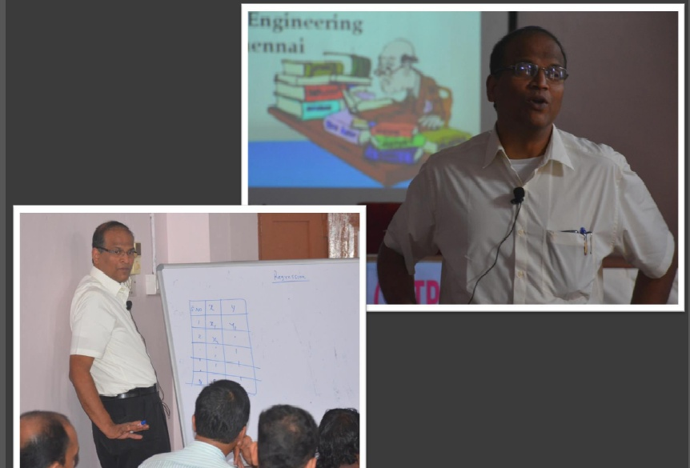
Prof. C. Balaji, IIT Madras handling a session during STTP on Optimization Methods and Application

Slide 28
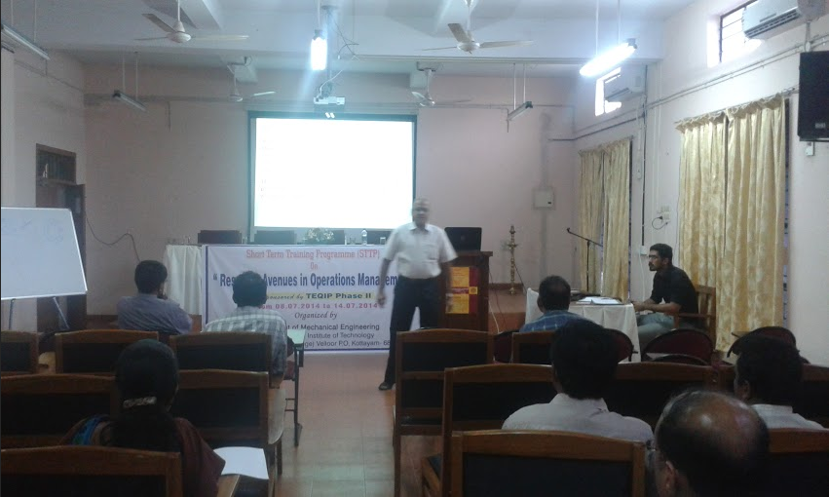
Prof. Srinivasan, IIT Madras handling a session during STTP on Research Avenues in Operations Management

Slide 29
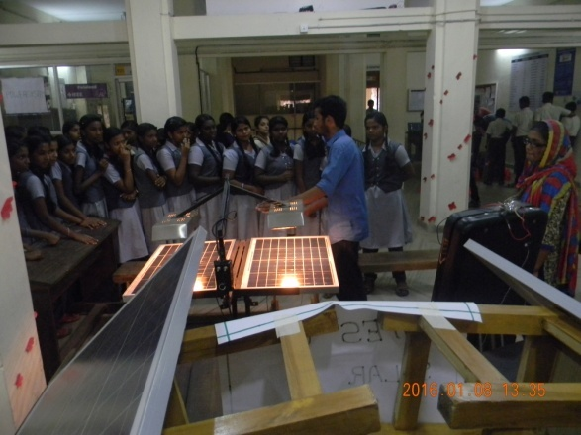
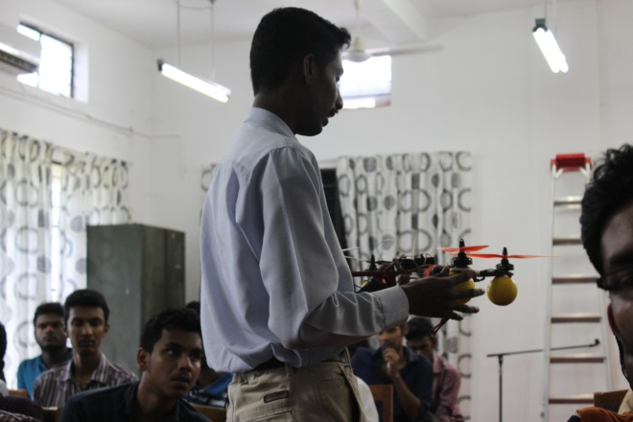
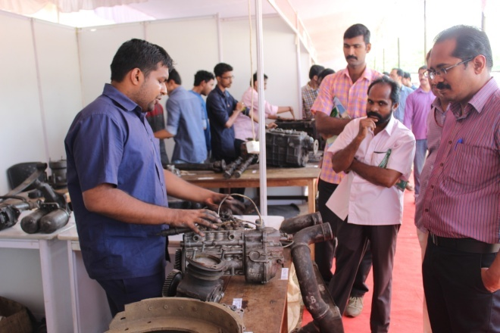
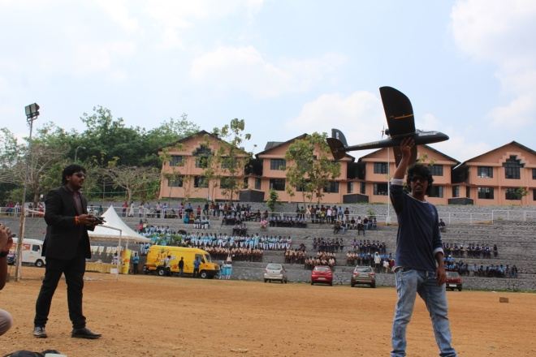
RITEXPO 2016

Slide 30
Focus 2020
Start new courses: M.Tech (Engineering Design)
                M.Tech (Mechatronics)
Start Research Center (Mechanical Engg)
Start Center of Excellence in Ergonomics
Focus on Thrust Areas: Design
                Industrial Engineering
                Energy

Slide 31
THANK YOU

